Slide 1
INTEGUMENTARY SYSTEM RESEARCH PROJECT
Hair color/dye
Burns/skin grafting
Sweat dysfunctions
Botox injections
Freckles & moles
Bruising
Skin color variations/ birthmarks
Tattoos
Gauges
Scars
Permanent make-up
Facials
Face transplants
There are so many interesting, controversial & cutting-edge topics when it comes to the Integumentary System!
In replacement of an Integumentary System Exam (60 pts), you will be responsible for researching & producing a Research Project on an Integumentary topic.
- You will have multiple quizzes throughout the unit & you will see the information in the lecture notes on your Semester Exam!

Slide 2
INTEGUMENTARY SYSTEM RESEARCH PROJECT
Rubric that will be used (60 pts)…each criterion is worth 10 pts.
Define, discuss & explain the topic & its relevance/ importance to the Integumentary System using anatomical/Integumentary terminologies
Works Cited in MLA Format with Proper Research Citation
Minimum of 5 graphics (must pertain to topic)
Minimum of 2 statistical analyses via graph or raw data
Solo OR partners actively participated in research & project
A 5 question Quiz (Multiple Choice, Fill-in &/or Identification) turned in with Research Project

Slide 3
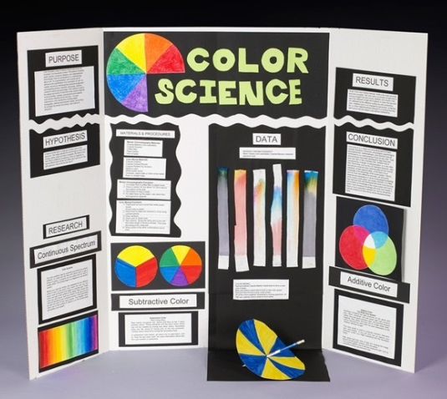
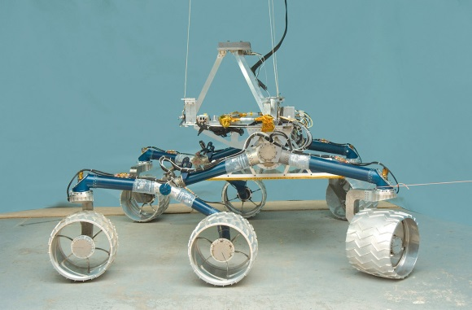
INTEGUMENTARY SYSTEM RESEARCH PROJECT
FORMAT of Project:
Physical model
Billboard display
Brochure/pamphlet
Video
Skit/play
Any other format EXCEPT a PowerPoint/ Prezi presentation
GET CREATIVE!!!!

Slide 4
INTEGUMENTARY SYSTEM RESEARCH PROJECT
REMEMBER: This is your INTEGUMENTARY SYSTEM EXAM grade!
There will be NO IN-CLASS WORK TIME dedicated, so it will also require out-of-class work time!
Decided whether you would like to work with a partner or solo. Stand/sit next to your partner, if you have one.
I’m going to make my way around with my “Can o’ Topics”.
Please pick 1!
Write your TOPIC on your RUBRIC!
Exchange phone numbers &/or e-mails so you can contact each other about meeting & dividing up work!

